Slide 1
Associate Recognition through Associate Lens
ADM Tech Office
Feb - 2021

Slide 2




Associate Recognition
Recognize people who went above and beyond to close Automation/Healing tickets ,create knowledge articles (KEDB)
Creating a culture of value delivery on day-to-day work
Increased closure of A/H tickets to move towards zero maintenance
Creates an opportunity for AMS associates to upskill and get better coding practices
Promotes community -based work culture without project boundaries
Why?
Category | Award Name | Criteria
Application Healing Solution | The Iron Pillar | Closure of at least 1 Healing ticket in AppLens in reporting month
Automation Solution | The Automation Master | Closure of at least 1 automation ticket in AppLens in reporting month
Creation of KEDB articles | The Ultimate Contributor | Closure of at least 1 Knowledge ticket in AppLens in reporting month
Contribution to code share | The Ultimate Contributor | Contribute 1 code asset through Code Share module in reporting month. Applicable for all contributor of same asset
Guild and COP opportunity creator | The Hyper citizen Award | Create at least 1 opportunity in Guild and COP module of AppLens to adopt community-based work culture in the reporting month
Guild and COP opportunity Seeker | The Hyper citizen Award | Contribute to at least one of opportunities in the Guild and COP module and adopt community - based work culture in the reporting month
On monthly basis, the top 5 contributors at ADM level under each category will be awarded with Amber (14$) through Cheers portal funded from ADM Tech Office
© 2020 Cognizant
Digital certificates will be auto generated and sent to the individuals copying the supervisor and EDL of the project

Slide 3
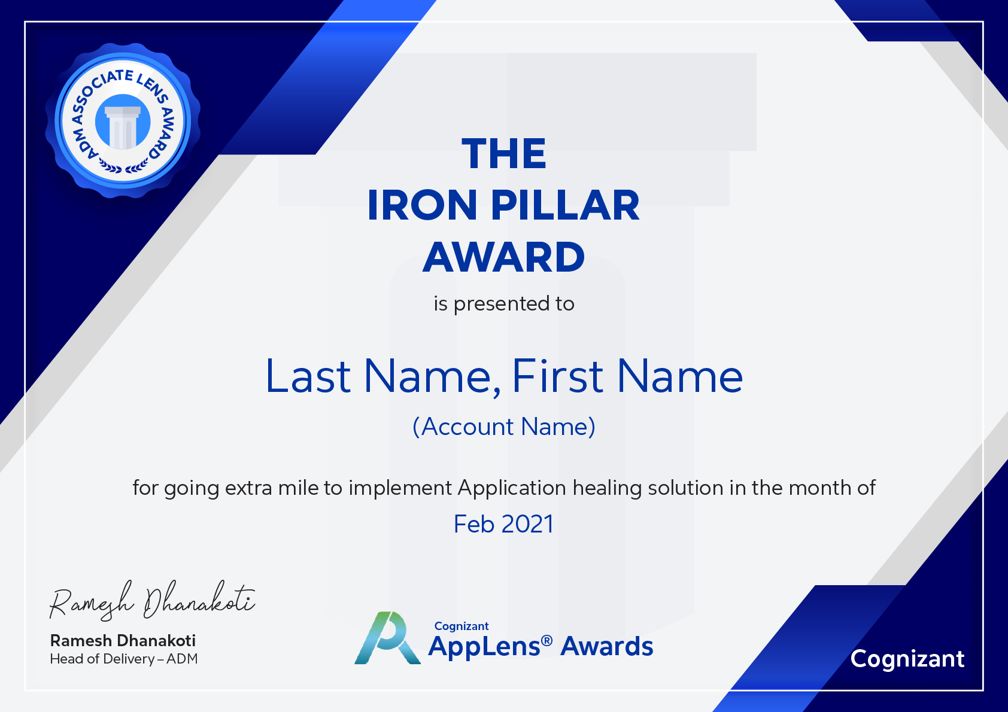

Slide 4
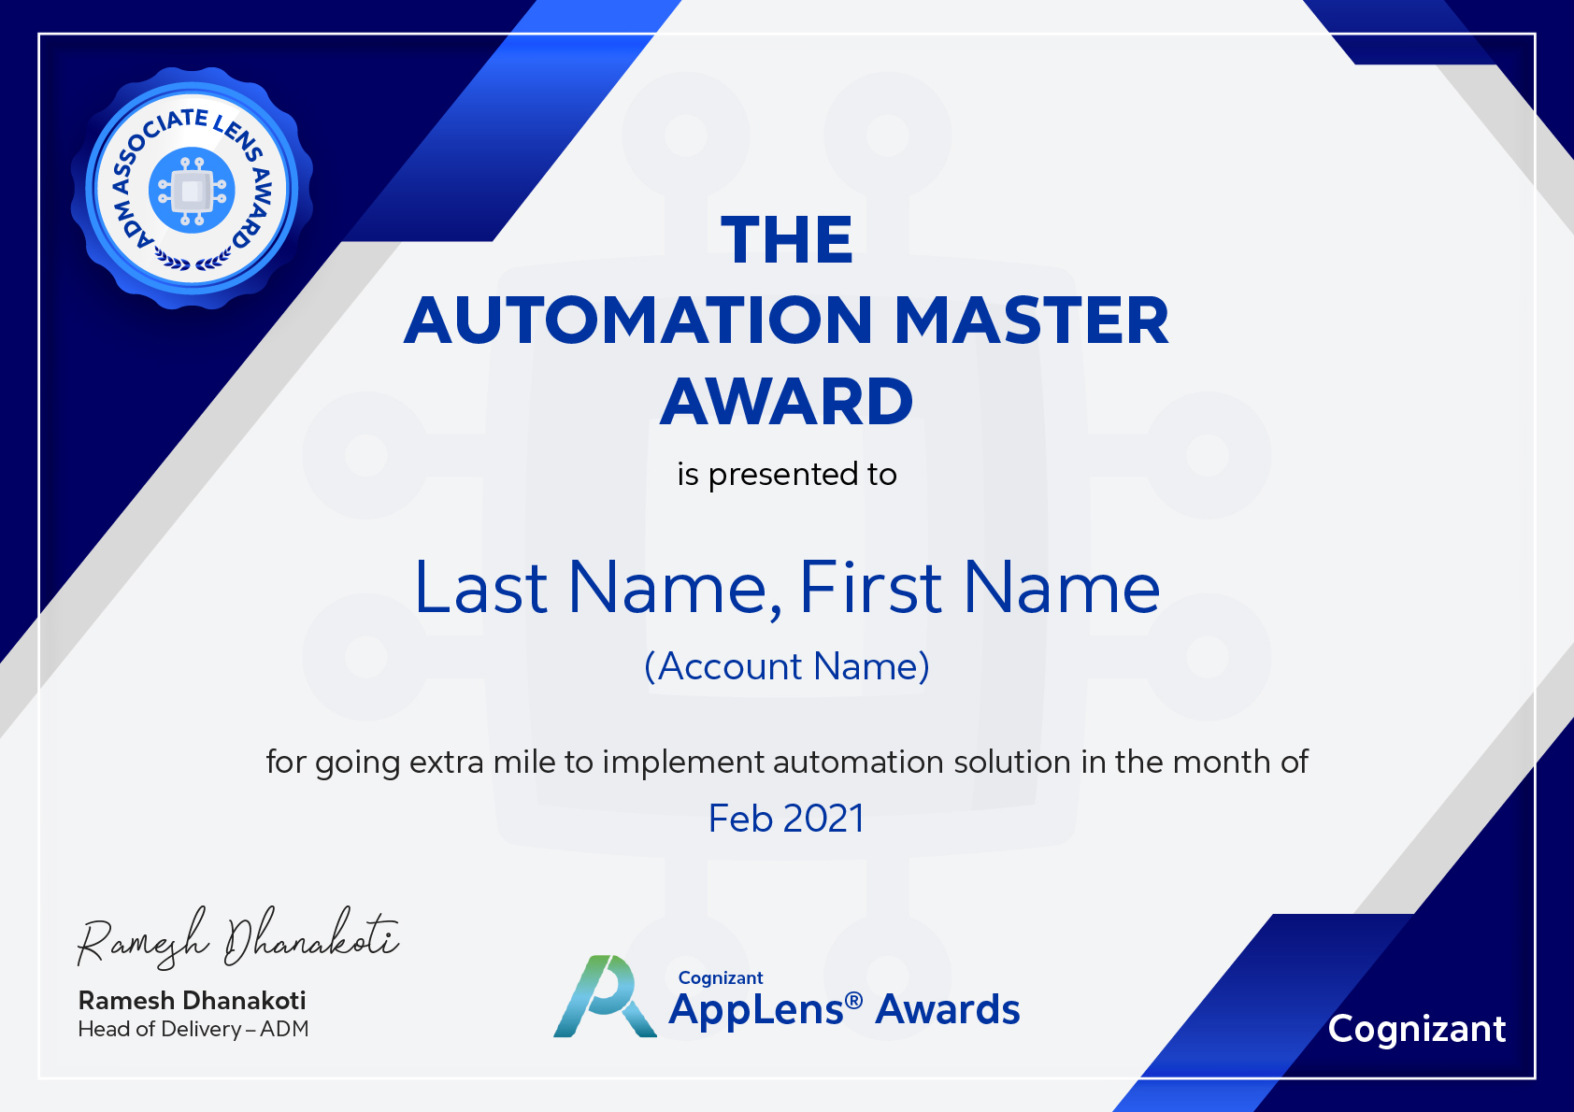

Slide 5


Slide 6


Slide 7


Slide 8


Slide 9
Business Rule
Category | Award Name | Criteria | Rule
Application Healing Solution | The Iron Pillar | Closure of at least 1 Healing ticket in AppLens in reporting month | 1) H ticket closed date is last month with assignee mapped. 2) Should not be a system closed one 3) If the person has closed more than 1 closed tickets across multiple projects, send only one certificate.CC to current HCM Supervisor and EDLs of all the projects where he had closed the tickets 4) If it is across account IDs, send multiple certificates
Automation Solution | The Automation Master | Closure of at least 1 automation ticket in AppLens in reporting month | 1) A ticket closed date is last month with assignee mapped. 2) Should not be a system closed one 3) If the person has closed more than 1 closed tickets across multiple projects, send only one certificate.CC to current HCM Supervisor and EDLs of all the projects where he had closed the tickets 4) If it is across account IDs, send multiple certificates
Creation of KEDB articles | The Ultimate Contributor | Closure of at least 1 Knowledge ticket in AppLens in reporting month | 1) KA creation date should be last month and approved with assignee mapped. 2) If the KA is created and approved in subsequent months, give the certificate in the approved month 3) If the person has created more than 1 KA across multiple projects, send only one certificate.CC to current HCM Supervisor and EDLs of all the projects where he had closed the tickets 4) If it is across account IDs, send multiple certificates
Contribution to code share | The Ultimate Contributor | Contribute 1 code asset through Code Share module in reporting month. Applicable for all contributor of same asset | Code asset is contributed and approved in last month If the person has contributed more than 1 asset across multiple projects, send only one certificate.CC to current HCM Supervisor and EDLs of all the projects where he had closed the ticket If it is across account IDs, send multiple certificates
Guild and COP opportunity creator | The Hyper Citizen Award | Create at least 1 opportunity in Guild and COP module of AppLens to adopt community-based work culture in the reporting month | Had created at least 1 Opportunity and made available for bidding in Guild and COP in reporting month At least one seeker had bid for the opportunity If the person had created more than 1 opportunity
Guild and COP opportunity creator | The Hyper Citizen Award | Contribute to at least one of opportunities in the Guild and COP module and adopt community - based work culture in the reporting month | Had placed at least 1 bid for an opportunity in Guild and COP At least 1 bid approved and Completed (code evaluation success) in the reporting month If the person had completed more than 1 opportunity ,send only one certificate.CC to current HCM Supervisor

Slide 10
Thank You!

